Slide 1



Introduction to
Disability Huntingdonshire

Slide 2

Benefits Overview
 | Personal Independence Payment (PIP) | Attendance Allowance (AA) | UC50 | Employment and Support Allowance (ESA)
Age range | 16 to under State Pension Age | State Pension Age | Under State Pension Age | Under State Pension Age
Elgibility | You can claim if: Over 16 years of age. Have a long term physical or mental health condition. Have difficulty doing certain everyday tasks such as washing and dressing or getting around. | You can claim if all following apply: Have a long-term physical or mental illness or disability Have needed help with personal care, or supervision to keep safe for at least six months before claiming. Are over State Pension Age. | To be eligible you must: Have a disability or Health condition that affects how much you can work. Have a Universal Credit Account. This is an additional element of Universal Credit. The form is sent automatically once “Fit notes” have been provided to the DWP. | You need to have: Worked as an employee or have been self-employed. •Paid enough National Insurance contributions, usually in last 2-3 years. Have a disability or Health condition that affects how much you can work.
Components/ Outcomes | Two components: Daily Living (Standard rate £73.90/Enhanced rate £110.40 p.w.) Mobility (Standard rate £29.20 /Enhanced rate £77.05 p.w.) | Two components: Lower rate Higher rate | Two Outcomes – 2 Groups: Limited Capability for Work Limited Capability for Work Related Activity | Two Outcomes – 2 Groups: Limited Capability for Work Limited Capability for Work Related Activity
Claim details | 0800 917 2222 | 0800 731 0122 |  | 0800 055 6688

Slide 3

Understanding PIP
Personal Independence Payment (PIP) provides financial support to help with additional living costs if you:
  Have a long-term physical or mental health condition, illness, or disability, and
  Experience difficulties with everyday activities or mobility as a result of that condition.
You can still qualify for PIP even if you are employed, have savings, or already receive most other benefits.

Slide 4
Understanding PIP
You can get Personal Independence Payment (PIP) if all of the following apply to you:
  You’re 16 or over
  You have a long-term physical or mental health condition or disability
  You have difficulty doing certain everyday tasks or getting around
  You must have had these difficulties for 3 months prior to claiming and expect them to continue for another 9 months at least
  You must also be under State Pension age if you’ve not received PIP before.

Slide 5








Understanding PIP: The Process
Start Claim
You complete the form with details about daily living and mobility difficulties.
PIP2 Form Sent (“How your disability affects you”)
Call Department of Works and Pensions (DWP). Basic details are taken (name, address, condition).
Return form (with evidence)
Send completed PIP2 form back to DWP by the deadline (request extension if needed).
Health Assessment
A face-to-face, phone, or video assessment with a health professional (if required).
DWP Decision
DWP reviews evidence and assessment report. You receive a letter with the outcome.
If Awarded
Payments start from the date of claim. Award length is usually reviewed in the future.
If Refused or Lower Award than Expected
You can request a Mandatory Reconsideration (appeal within 1 month).
If Refused at the Mandatory Reconsideration stage
Tribunal Appeal

Slide 6

PIP: Safely, Reliably, Repeatedly
Safely:
  The activity should be carried out in a way that is unlikely to cause harm to the claimant or others, either during or after completion.
To an acceptable standard:
  The task must be completed to a satisfactory level, as opposed to being done poorly or causing issues like self-neglect.
Repeatedly:
  The claimant must be able to perform the activity as often as reasonably required during the day, without significant fatigue or pain impacting the ability to repeat it.
In a reasonable time:
  The activity must be completed within a timeframe that is no more than twice the time a non-disabled person would take.

Slide 7

Understanding PIP: Activity Questions
Daily Living Activities
  Preparing food – Can you prepare and cook a simple meal for yourself?
  Eating and drinking – Do you need help to eat or drink?
  Managing treatment or monitoring health condition – Can you manage medication or therapy, or do you need support?
  Washing and bathing – Can you wash and bathe yourself, including getting in and out of a bath or shower?
  Managing toilet needs or incontinence – Can you use the toilet unaided and manage continence?
  Dressing and undressing – Can you choose and put on suitable clothing?
  Communicating verbally – Can you speak and be understood?
  Reading and understanding – Can you read and understand written information?
  Engaging with other people face-to-face – Can you engage socially and build relationships?
  Making budgeting decisions – Can you manage money and make budgeting decisions?
Mobility Activities
11. Planning and following journeys – Can you plan and follow a route safely and reliably?
12. Moving around – Can you stand, walk, or move around safely, reliably, and repeatedly?

Slide 8
Understanding PIP: Descriptors
Daily Living Examples
Preparing food
  Can prepare and cook a simple meal unaided. 0 points
  Needs to use an aid or appliance to be able to either prepare or cook a simple meal. 2 points
  Cannot cook a simple meal using a conventional cooker but is able to do so using a microwave. 2 points
  Needs prompting to be able to either prepare or cook a simple meal. 2 points
  Needs supervision or assistance to either prepare or cook a simple meal. 4 points
  Cannot prepare and cook food. 8 points
Washing and Bathing
  Can wash and bathe unaided. 0 points
  Needs to use an aid or appliance to be able to wash or bathe. 2 points
  Needs supervision or prompting to be able to wash or bathe. 2 points
  Needs assistance to be able to wash either their hair or body below the waist. 2 points
  Needs assistance to be able to get in or out of a bath or shower. 3 points
  Needs assistance to be able to wash their body between the shoulders and waist. 4 points
  Cannot wash and bathe at all and needs another person to wash their entire body. 8 points
To get an award of the daily living component, you need to score:
8 points for the standard rate | 12 points for the enhanced rate

Slide 9
Understanding PIP: Descriptors
Mobility Examples
Planning and following journeys.
  Can plan and follow the route of a journey unaided. 0 points
  Needs prompting to be able to undertake any journey to avoid overwhelming psychological distress to the claimant. 4 points
  Cannot plan the route of a journey. 8 points
  Cannot follow the route of an unfamiliar journey without another person, assistance dog or orientation aid. 10 points
  Cannot undertake any journey because it would cause overwhelming psychological distress to the claimant. 10 points
  Cannot follow the route of a familiar journey without another person, an assistance dog or an orientation aid. 12 points
Moving around
  Can stand and then move more than 200 metres, either aided or unaided. 0 points
  Can stand and then move more than 50 metres but no more than 200 metres, either aided or unaided. 4 points
  Can stand and then move unaided more than 20 metres but no more than 50 metres. 8 points
  Can stand and then move using an aid or appliance more than 20 metres but no more than 50 metres. 10 points
  Can stand and then move more than 1 metre but no more than 20 metres, either aided or unaided. 12 points
  Cannot, either aided or unaided, –stand; or move more than 1 metre. 12 points
To get an award of the Mobility component, you need to score:
8 points for the standard rate | 12 points for the enhanced rate

Slide 10

Understanding PIP
Support from Other People
The assessment considers situations where an individual requires help from another person to carry out an activity – including cases where the activity must be completed entirely by someone else on their behalf. The criteria recognise three distinct types of support:
  Assistance – Direct, hands-on help from another person, involving physical intervention to complete some or all of the activity. This does not include prompting or supervision. Assistance may be required for only part of the activity.
  Prompting – Verbal encouragement or reminders to begin or complete a task, without physical help. Prompting may be required for only part of the activity.
  Supervision – The need for another person to be continuously present to prevent a serious risk to the individual’s safety. There must be evidence that such a risk is likely to occur without supervision. Supervision must be required throughout the entire activity.
Unaided
Within the assessment criteria, performing an activity unaided means doing so without the use of aids or appliances, and without any assistance, prompting, or supervision from another person.

Slide 11
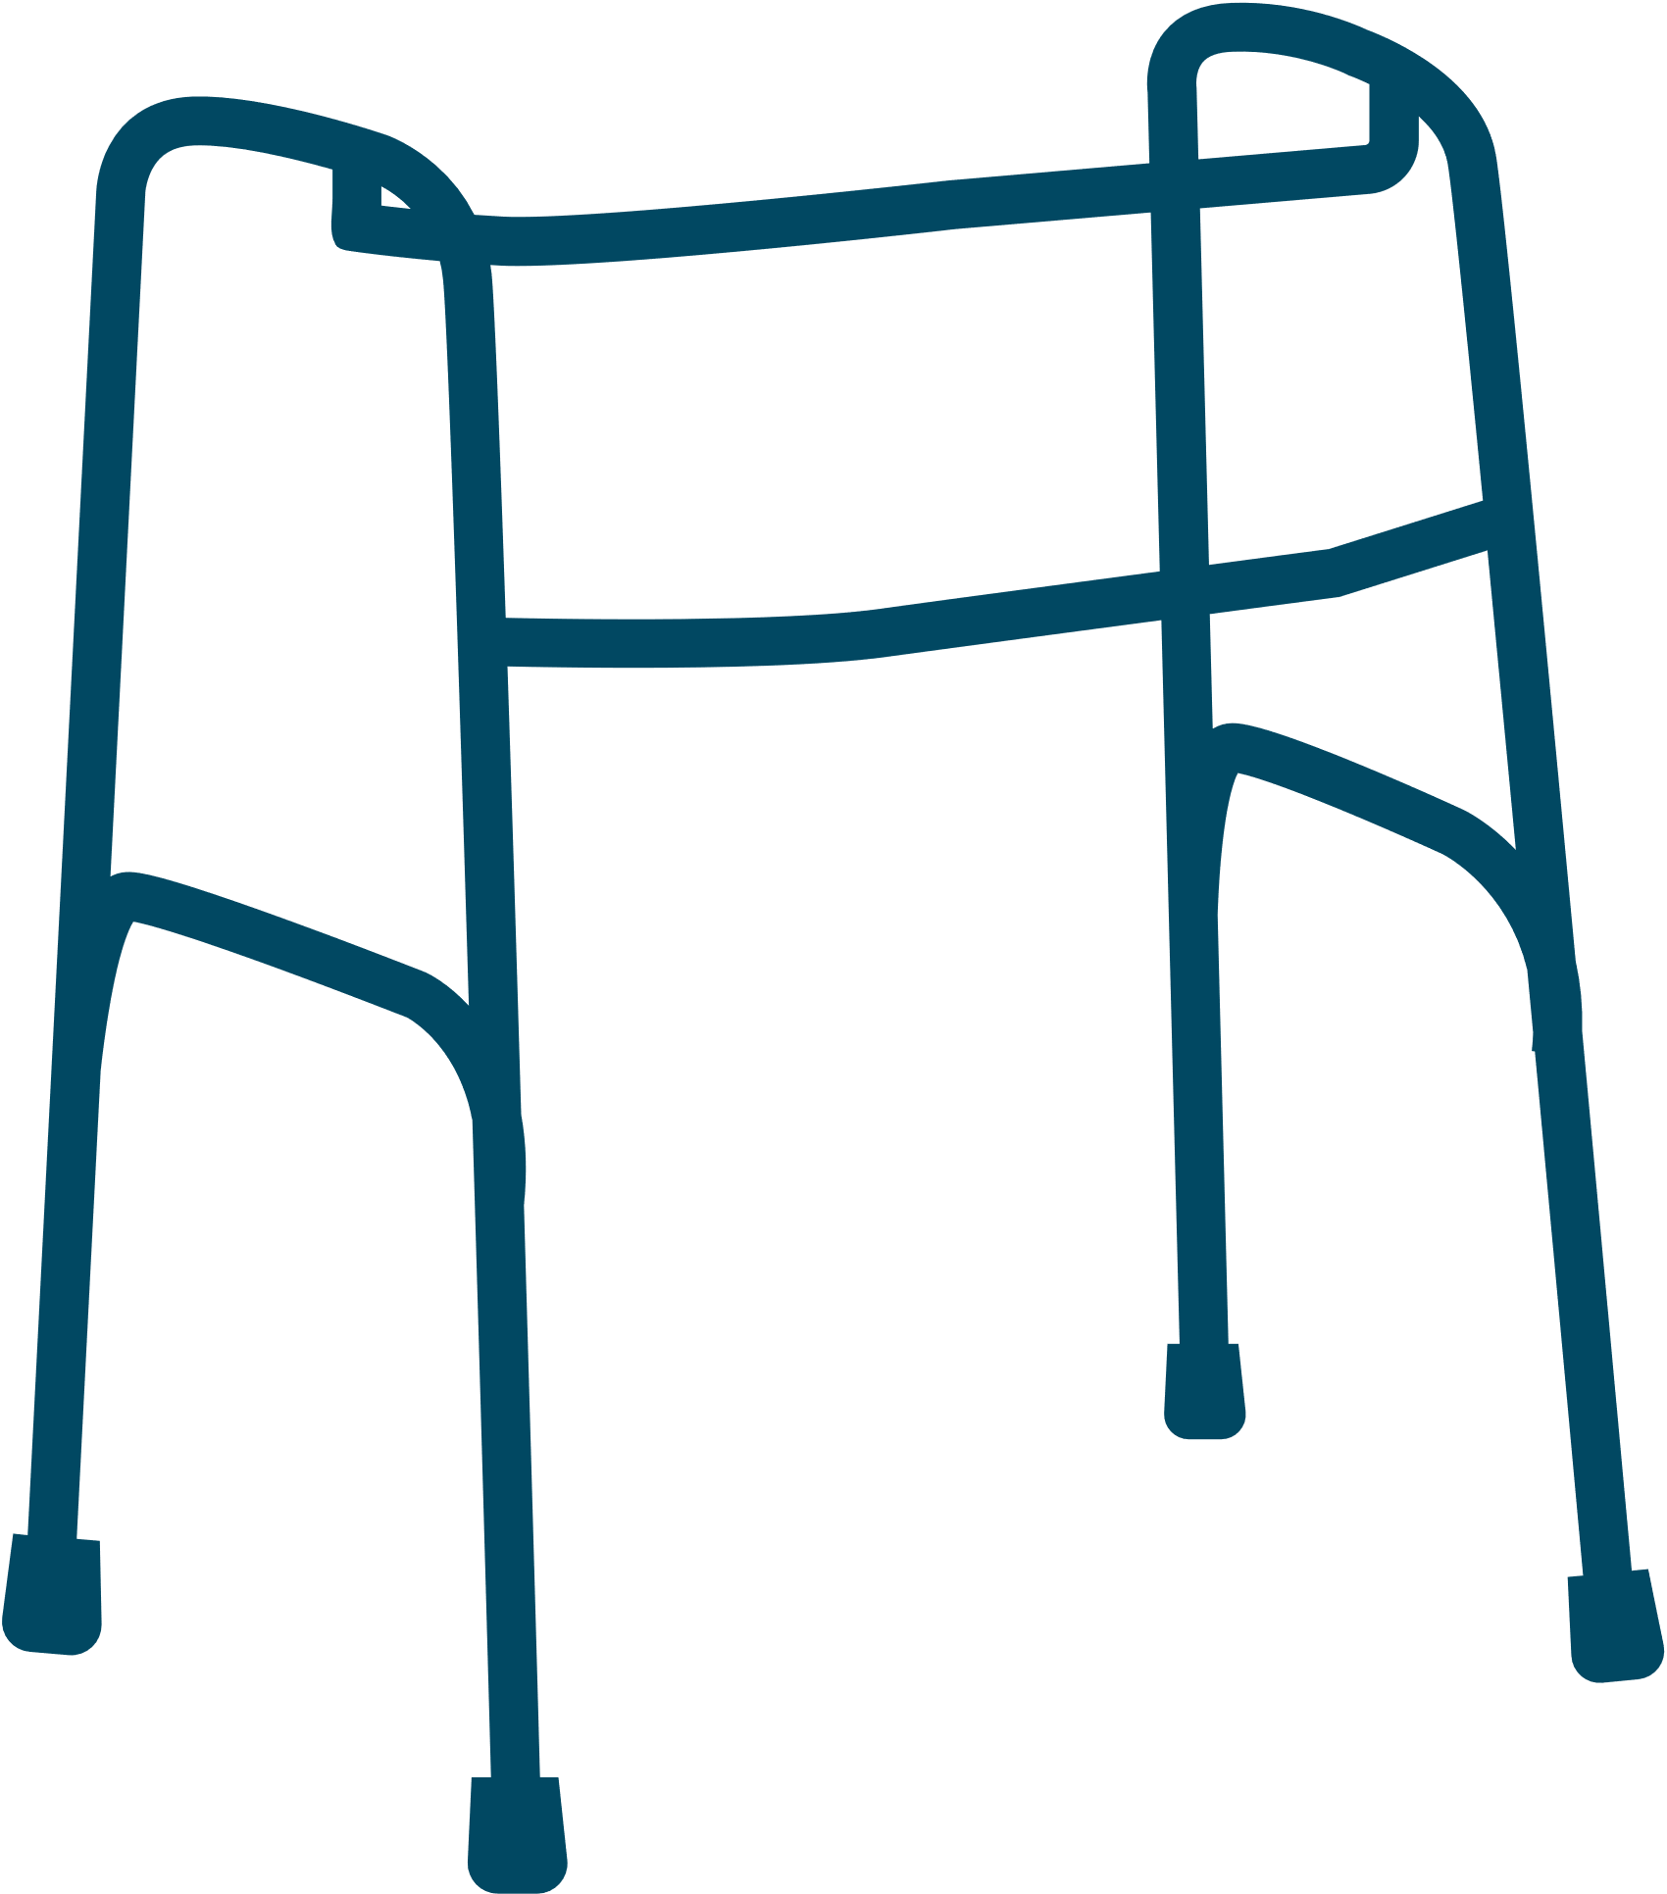



Before making a referral
DISH is unable to support with care, equipment, housing benefit, council tax support.
When talking with clients, please use the phrase ‘may be eligible’, rather than ‘you are entitled’
Check older clients are not on DLA (Adults), before referring for Attendance Allowance.
Explain that you are referring the client to us

Slide 12



Guidance for the client
Explain that we will be in touch to discuss their referral and arrange appointment. Provide them with our contact details.
Make sure the individual has the necessary forms
Ask them to obtain an extension to submission, if the client has the forms. It is acceptable reason for awaiting support appointment.

Slide 13
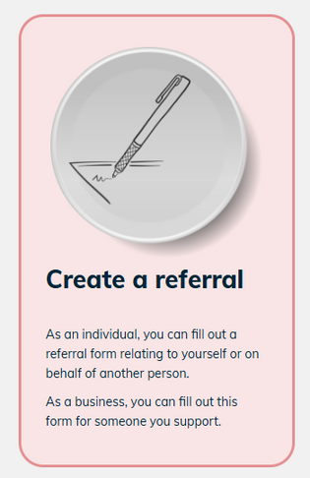



Making a referral
Visit our website - www.dish.org.uk
Click on Contact us, then on Create a referral.
Please read the guidance at the top of the page
Complete the referral form and click submit.

Slide 14





Next steps
We will review the referral
A caseworker will be assigned to the client
An appointment will be booked, face-to-face or over the phone
Forms completed

Slide 15





How to contact us
info@dish.org.uk
www.dish.org.uk
0330 3553 256
Disability Huntingdonshire
The Maple Centre
6 Oak Drive
Huntingdon
PE29 7HN

