Slide 1


Carers Support
Healthwatch Summit 2025

Slide 2

Jill Nooij
Awareness and Voice Delivery Lead

Slide 3
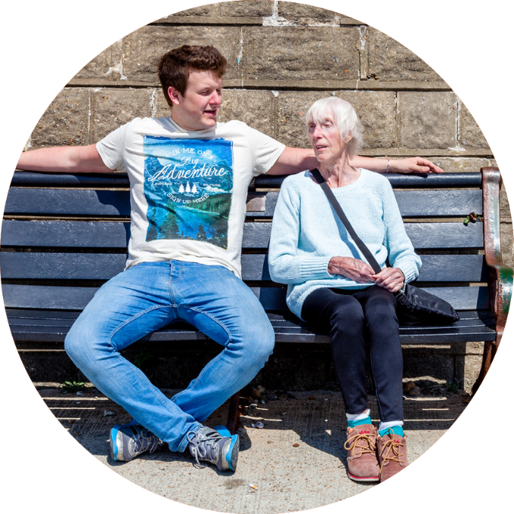


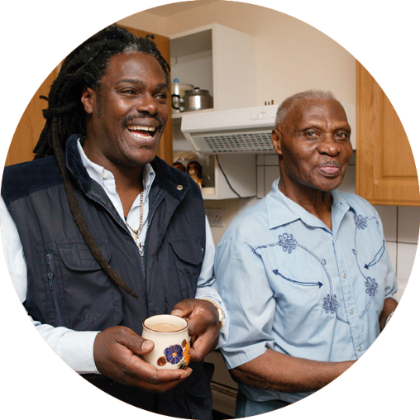
About us
At Caring Together our vision is a world with no unpaid carer in crisis, isolated or struggling alone.
It is our mission that people know where to go for help before, during and after their caring role and get the practical support that matters.
3 in 5
More than 3 in 5 of us will
become an unpaid carer.
12,000
Every day, on average, 12,000 people in the UK
take on a caring role.
That’s 82,000 people
a week.

Slide 4
Carers Rights

Slide 5

Hospital Discharge
Carers have the right to be consulted.
Under the Care Act 2022 NHS hospital trusts in England must ensure that unpaid carers are involved as soon as feasible when plans for a patient’s discharge after treatment are being made. This covers all carers of adults needing care and support following hospital discharge, including health care support.
Notes:
https://www.caringtogether.org/advice/hospital-admission-and-discharge-planning/
https://carersmatternorfolk.org.uk/information-and-advice/your-rights/hospital-admission-and-discharge-planning/

Slide 6

Carer facts
3 out of 10 carers had been asked if they were willing and able to care.
Notes:
The majority of carers were not asked whether they were willing and able to care (7 out of 10). 68% disagreed or strongly disagreed when asked if they were asked about their willingness and ability to care at discharge. Only one in five, (21%) agreed or strongly agreed.
Carers UK ran a survey in March 2021 asking carers’ for a range of their experiences including at the point of hospital discharge. 2,850 carers responded overall, with 1,950 from England

Slide 7

James's Story
https://www.youtube.com/watch?v=CJXvROXEa3I

Slide 8
Employment Rights
To ensure that carers are supported and treated fairly in the workplace.
The Equality Act 2010 and The Carer’s Leave Act 2023

Slide 9
Carer facts
On average, 600 people a day leave work to care
Notes:
(Carers UK, Juggling Work and Care).

Slide 10

Employment Rights
The Equality Act 2010 protects people caring for someone who is an older person or who has a disability as they are associated with someone who is protected by law. For example, you could not be turned down for a job because of your caring role.
Statutory rights are by law and everyone has them. Contractual rights are what are in your contract of employment. You can check your contract of employment to see what these are for your job.

Slide 11
Carer’s Leave Act
The Carer’s Leave Act came into force on
6 April 2024 and is now law.
The Carer’s Leave Act 2023 provides much needed employment rights for people who juggle their unpaid caring responsibilities with paid employment.
The law gives carers who are balancing unpaid care with paid employment the legal right to five days of unpaid carer’s leave.

Slide 12
Carer’s Leave Act 2023
The act defines caring as someone who looks after someone who:
Has an illness or injury requiring care for more than three months.
Has a disability.
Or requires care because of old age.

Slide 13
Carer’s Leave Act 2023
Carer’s leave is for planned commitments. Unforeseen caring situations are covered by the statutory right to time off for dependants in emergencies.
Carer’s leave is separate to (so comes on top of) parental leave rights for parents of a disabled child.
The Carer’s Leave Act means carers are subject to the same employment protections that are associated with other forms of family related leave.

Slide 14




Carer Friendly Tick Award

Slide 15
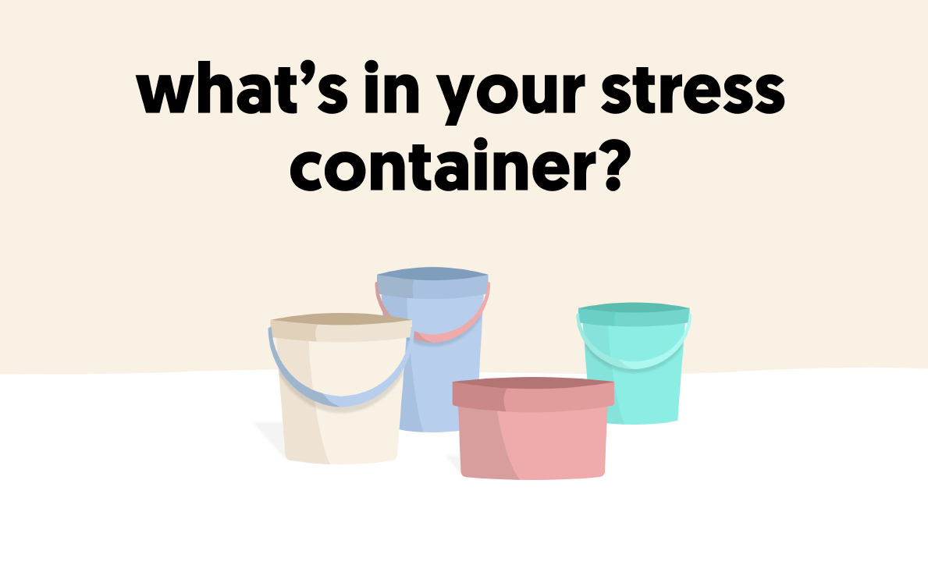


Notes:
A big contributor to poor mental health can be stress. Stress is a normal reaction to being under pressure and it is important to remember that some stress can be beneficial. Without a little stress we may not be motivated to achieve or even get ourselves out of bed in the morning.
However, too much stress, particularly over a long period can affect our minds and bodies.
A good way to visualise our stress tolerance is with the ‘stress container’.

Slide 16
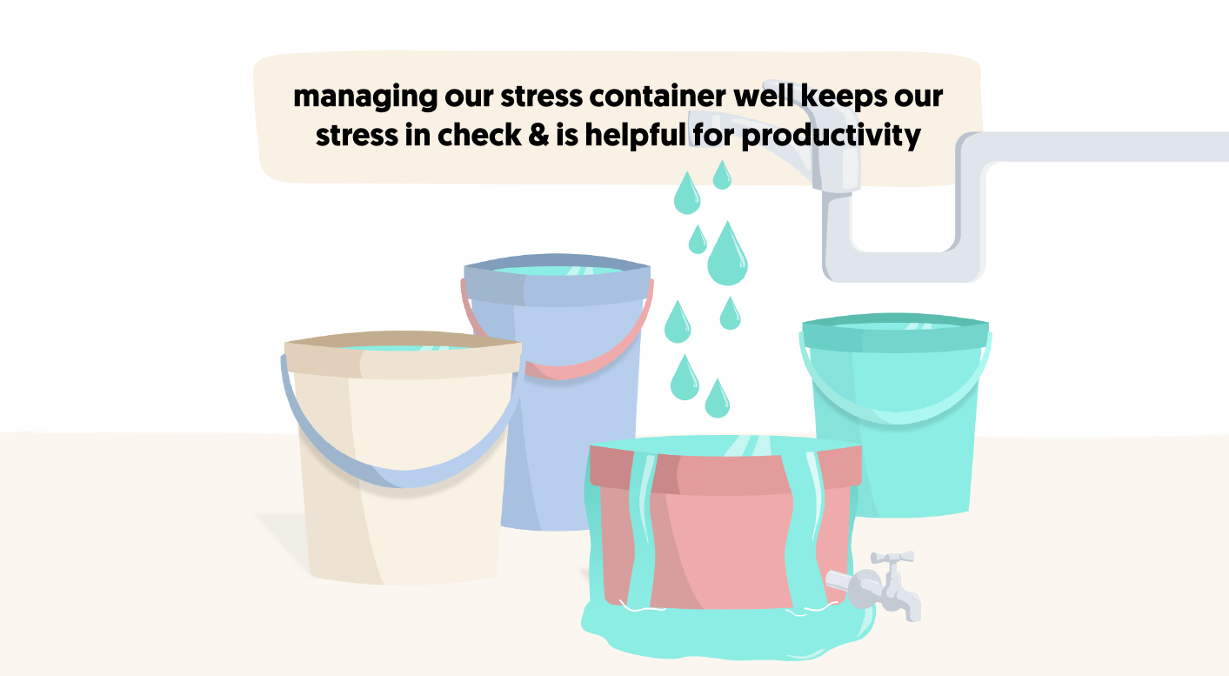
Notes:
The good news is that now we know there is this balance, we can try to be more in tune with when we are getting ‘full up’ and take steps to open our release valve some more.
Was that useful? What did you think of that image?
What are your signals the container is getting full?
So what can we do to help the release valve? (next slide)

Slide 17
Top 10 tips for Carers
Tell your GP you are a carer
Reach out to family / friends for support
If needed, apply for a blue badge
Register for power of attorney
Think about having a Carers Assessment/Needs
Financial check – Carers Allowance
Carer support groups
Carer Rights - employed – let you employer know you are a carer
Access support from other organisations – Alzheimer’s Society, Age UK, Parkinsons etc
Register for a carers magazine / e newsletter
Emergency planning in place - Register for a what if?
Your own self-care – carer breaks

Slide 18
Carer facts
60% of carers report a long-term health condition or disability.
Notes:
(Carers UK, Juggling Work and Care).

Slide 19
Support for carers
Cambridgeshire
Advice helpline
Hubs, groups and peer support
Homecare
Emergency planning
Counselling
Magazine and email newsletter
Carer Friendly Tick Award
Parent carer support.

Slide 20
Support for carers
Making Space
Rethink
Centre 33
Pinpoint
Family Voice

Slide 21
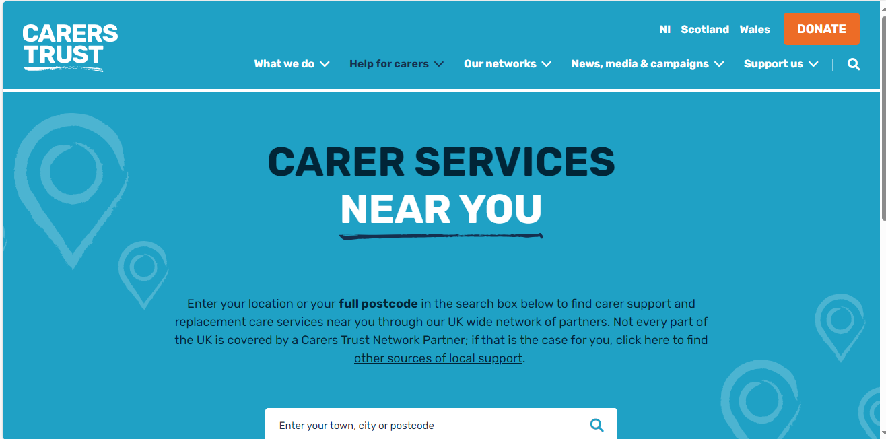

Slide 22
Carers and Mental Health
Jonathan Wells
Rethink Carer Support – Cambridgeshire and Peterborough
October 2025

Slide 23
Key Points
Families are crucial in helping their loved one with mental health conditions
Their role includes carrying on supporting their loved one, understanding what helps and what doesn’t help, being a key part of care plans and safety plans, giving information to CPFT and other staff
Being an unpaid carer can be really tough; so it’s absolutely right to look after yourself!
Triangle of Care

Slide 24
Key Issues
Isolation and stigma
Significant problems in accessing and getting a clinically effective services from NHS and social care
Navigating over-complicated systems
Confidentiality rules

Slide 25
Key Local Supports
Your own family and friends – talk about your situation
Know your rights as a carer whether or not you like the term
Making Space
Rethink Carer Support
Caring Together
Centre 33 Young Carers Team

Slide 26
Mental Health Act - 1
The nearest relative has certain powers when the NHS and the local authority are deciding whether their loved one should be detained in a mental health inpatient unit
The nearest relative is not the same as the next of kin or the designated carer
Detention or “sectioning” is generally based on 2 medical recommendations and an application by an Approved Mental Health Professional (usually a social worker)
A Section 2 admission is for up to 28 days and is for assessment or assessment followed by treatment

Slide 27
Mental Health Act - 2
Section 3 is for up to 6 months and is for treatment
Section 4 is an emergency detention and lasts for up to 72 hours
Section 117 applies to patients who have been detained under a S3. It says that the NHS and local authority have a duty of aftercare to everyone who has been on a S3. This care is a legal right and should be free.

Slide 28
Mental Health Act - 3
S11 (4) gives the nearest relative the power to object to and thus prevent the detention of their loved one under S3
S13 (4) gives the NR the right to ask the local authority’s Approved Mental Health Professionals’ Team to consider their loved one’s case for detention. If they decide not to set up a full MHA assessment they must give their reasons in writing
S23 (2) gives the NR the right to apply for the discharge of their loved one from detention in hospital on a S3. This can be barred by the Responsible Clinician

Slide 29
Mental Health Act -4
More information is available from
- your local Rethink Carer Support jfgwells57@gmail.com
- MINDhttps://www.mind.org.uk/information-support/legal-rights/mental-health-act-1983/about-the-mha-1983/- Rethink Mental Illness

Slide 30
Any questions?
Notes:
Reminder to follow us on social media
Sign up for magazine and inside news – www.caringtogether.org/keepintouch

