Slide 1

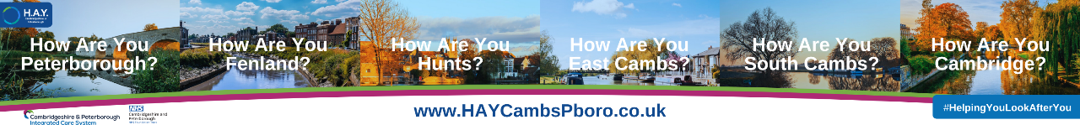
Looking After Your Own Mental Health
The story of H.A.Y. Cambridgeshire & Peterborough and LAMP
Trish Barker-Barrett, System Engagement Lead | H.A.Y. Team Manager Trish.Barker-Barrett@cpft.nhs.uk

Slide 2
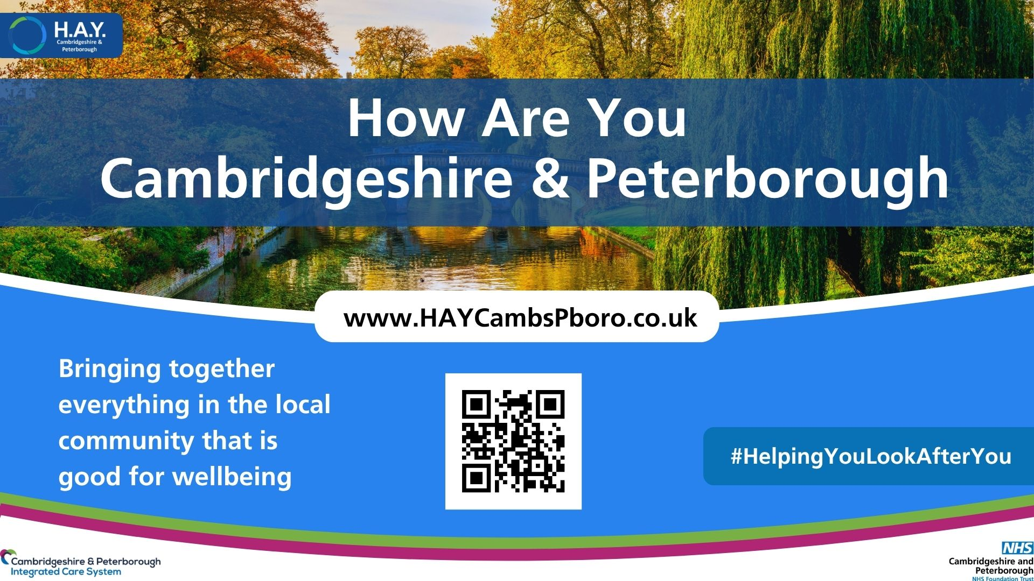

Slide 3
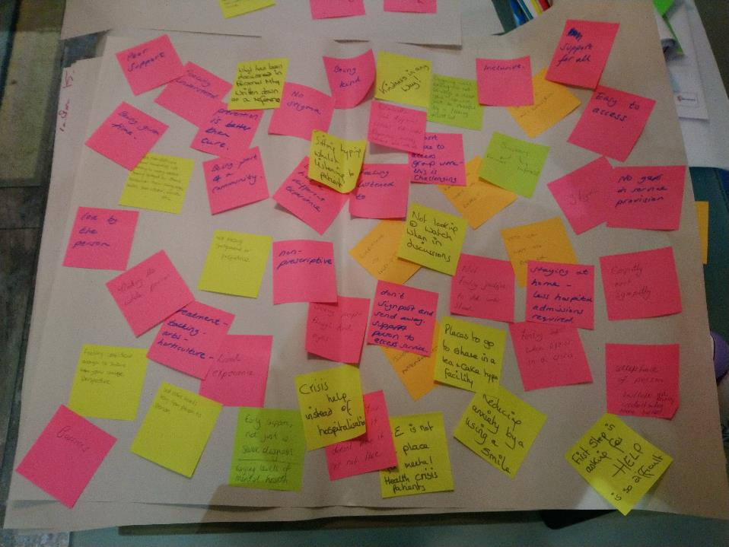


What does mental health care look like to you?
Our story: coproduced with local people

Slide 4
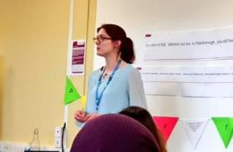
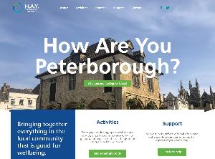
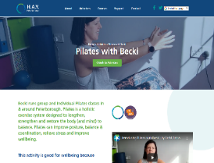
How Are You is a community engagement team working within CPFT who think creatively about solutions to mental health need and connect community assets to clinical care.
The team manage a set of local websites which they use to share knowledge with both the general public and those working and volunteering to support people across C&P.
The websites bring together everything in the local community that is good for wellbeing.
www.HAYCambsPboro.co.uk
super local
non-clinical
more than a directory

Slide 5
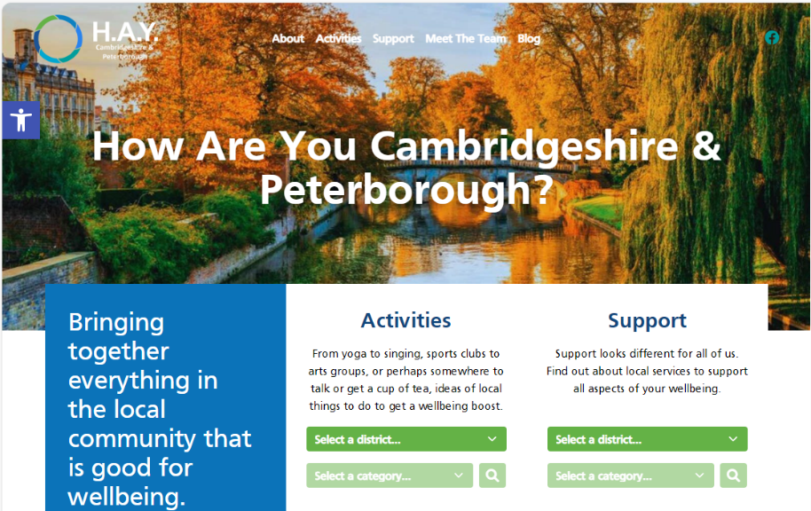
www.HAYCambsPboro.co.uk

Slide 6
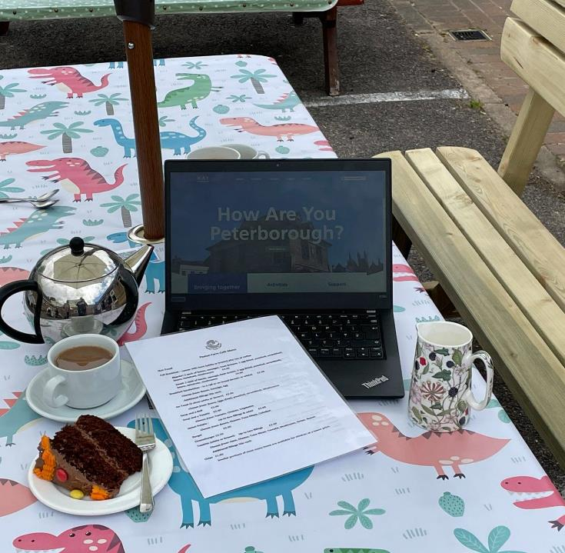
Our Digital & Community Engagement Coordinators
The heart of H.A.Y. is engaging with local people, constantly coproducing:
  finding all the local gems that provide a boost to wellbeing
  creating content with activity, group and service leads to share on the website
  sharing other content from the site with them
Then embedding this knowledge across Cambridgeshire & Peterborough

Slide 7
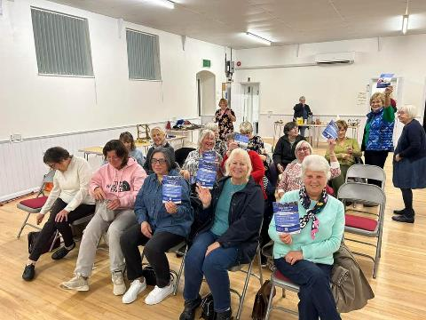
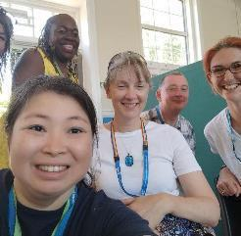
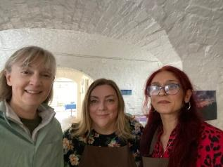
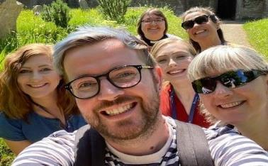
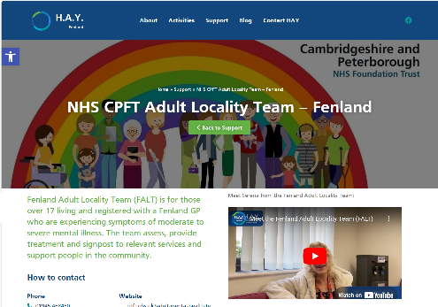
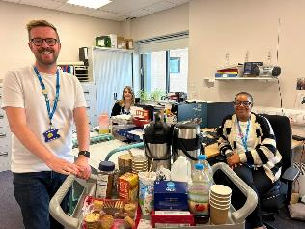
Weaving community into clinical care
Updates and support to clinical team meetings
Introducing Support Workers in community services to local community assets
Connecting with inpatient activity coordinators & discharge teams
Primary care connections through social prescribers (and others!)
VCSE partners events

Slide 8
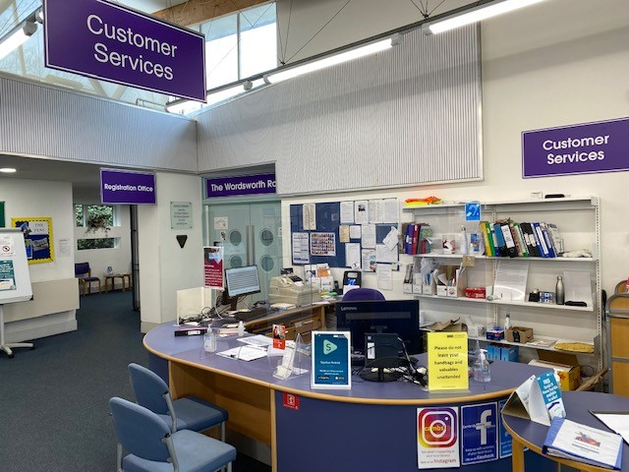
Taking wellbeing beyond health and social care
The H.A.Y. Team work with colleagues across community venues to bring wellbeing support to local people through knowledge of local activities and support.
Supporting local people wherever they seek support.
#HelpingYouLookAfterYou

Slide 9
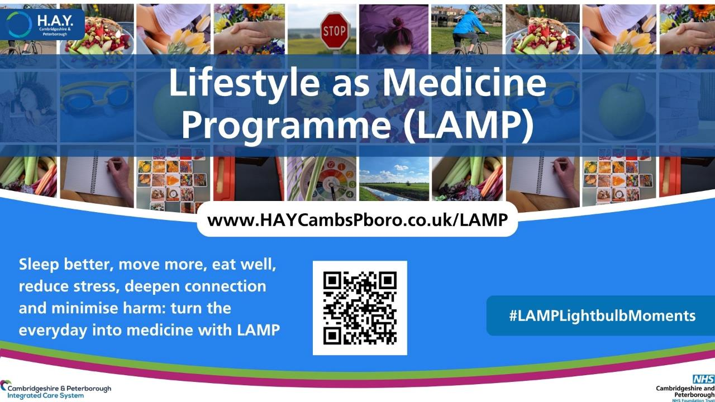

Slide 10



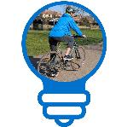
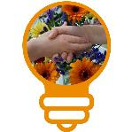



H.A.Y. & Lifestyle Medicine
Eat Well
Reduce Stress
H.A.Y. is proudly guided by local voice but grounded in the evidence base of Lifestyle Medicine
  We asked people what mental health care really meant to them and they spoke of the richness of community activities through to specialist support services
  We listened to how best to celebrate the full spectrum of ideas – H.A.Y. was the output.
  Behind the scenes we worked hard to ensure that lived experience expertise was grounded in a scientific evidence base - the discipline of Lifestyle Medicine gives us exactly that.
H.A.Y. team supported by a Lifestyle Medicine Lead, Dr Claire Gillvray
Move More
Deepen Connection
Sleep Better
Minimise Harm

Slide 11
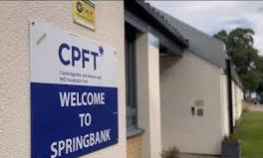
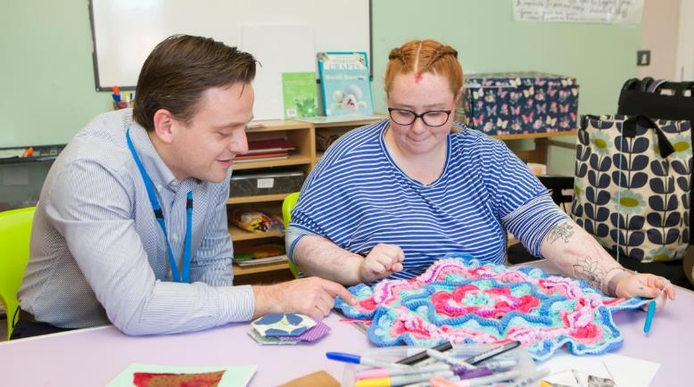
An inpatient ward ask for more movement
Staff asked us to help them increase the amount of physical activity on the ward timetable
Our initial coproduction with the patients – they didn’t want more physical activity! But they were very interested to learn more about sleep
By the end of the programme, the patients themselves had brought more movement to their timetable
Patient feedback:
  ‘All been really useful, especially sleep and movement sessions’
  ‘Really good that it was run by a GP as she was very knowledgeable about the topics’
  ‘Helpful to be given… information to take away, like help sheets and resources for us to keep after the groups’

Slide 12
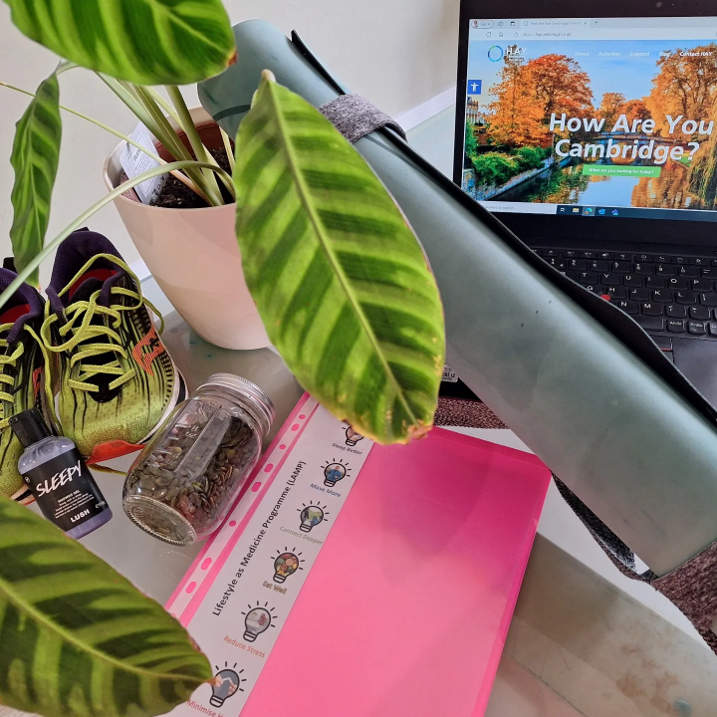
Coproducing LAMP with inpatients – pillar SPARKS
S | Starting point: | LAMP encourages you to reflect kindly on where you are right now
P | Proof: | Learn what the scientific evidence tell us about how this concept supports our health
A | Actionable ideas: | Gather ideas that help others and consider what you could try
R | Relate: | Understand how different lifestyle factors relate to one another
K | Knowledge: | Tap into a knowledge library of supportive resources and local opportunities
S | Self-Reflection: | Use all of the above to help you reach own goals

Slide 13
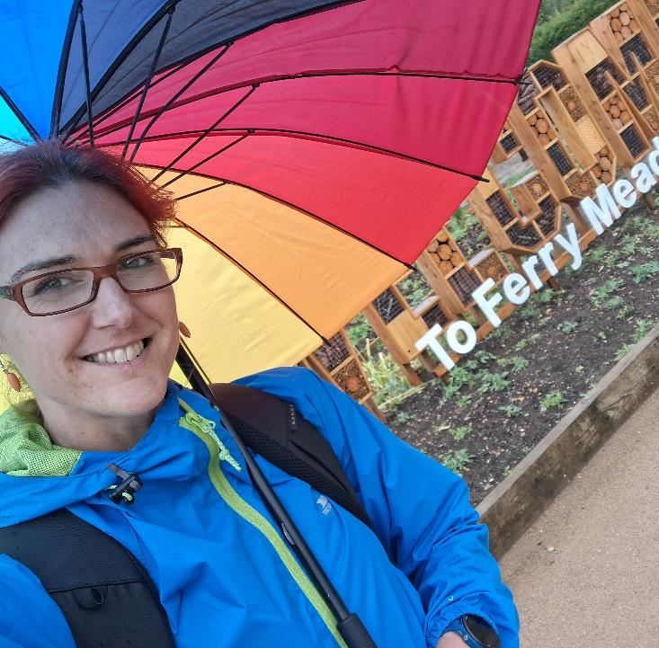
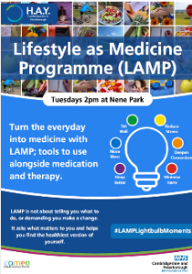
Taking LAMP to Community MH Services: CAMEO N
For a patient group where attendance was an anticipated challenge, the group became structured around SPARKS but with the ability to join at any time and for missing sessions not to be a barrier.
Group motivation was different; the Springbank patient ask was learning to then apply, the need here was doing alongside.
  We delivered the group out in the community, walking at Nene Park and using their community hub space.

Slide 14
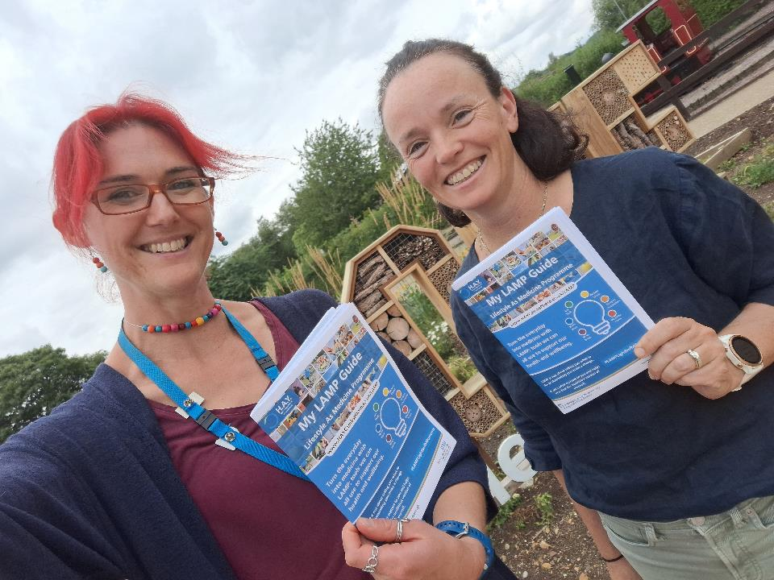
Coproducing LAMP resources: digital & paper
Just like Springbank, there was an ask for resources, both for the staff team supporting who hope to run the group in the future, the patients themselves, and their carer and support network.
A paper booklet of the programme was developed to ease the pressure of remembering content and smooth any gaps in attendance.
Further video content was added to the webpages so people could connect between sessions.
Notes:
Flipbook

Slide 15
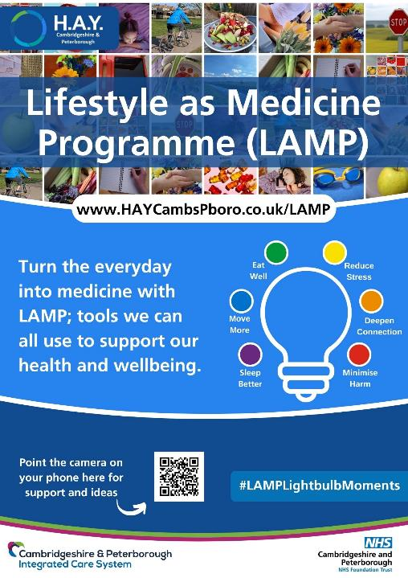
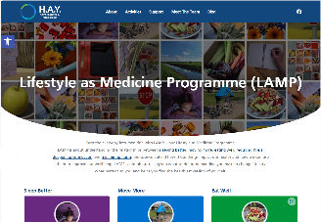
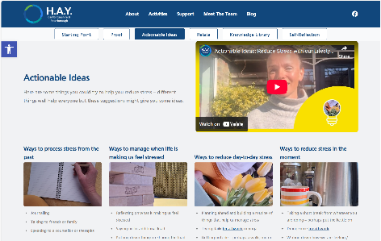
SMI to Population Health Resources

Slide 16
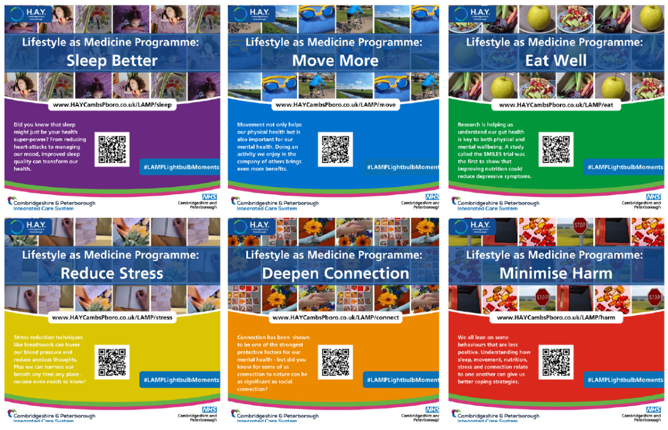
Treatment to Prevention: turn the everyday into medicine

Slide 17
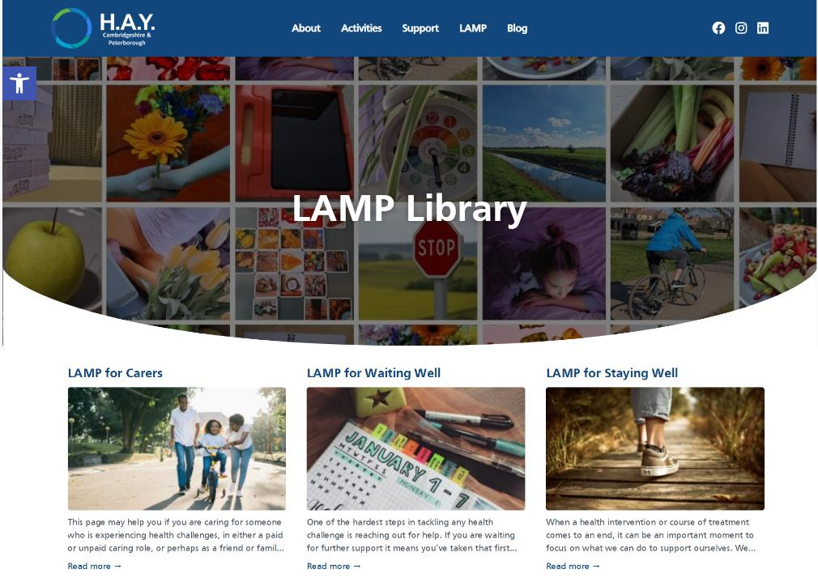
The LAMP Library

Slide 18
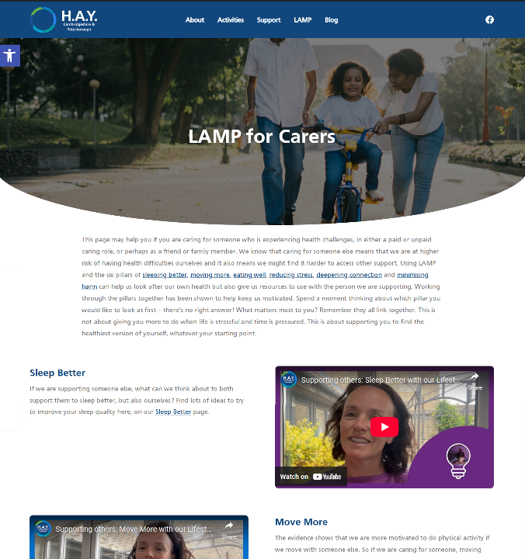
LAMP for…

Slide 19
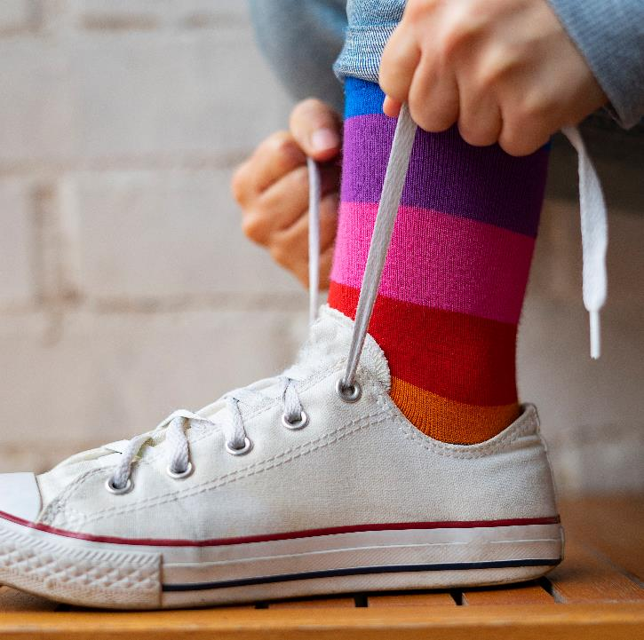
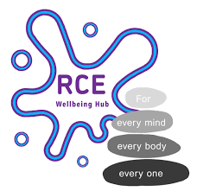
Who else might LAMP support?
LAMP embodies the values of H.A.Y. #HelpingYouLookAfterYou
Partners across the system have reached out to think how LAMP could support the people they care for.
We are excited to share that LAMP is coming to CPFT’s RCE Wellbeing Hub from November!

Slide 20


Questions?
Please Trish by email at:
Trish.Barker-Barrett@cpft.nhs.uk

